Slide 1
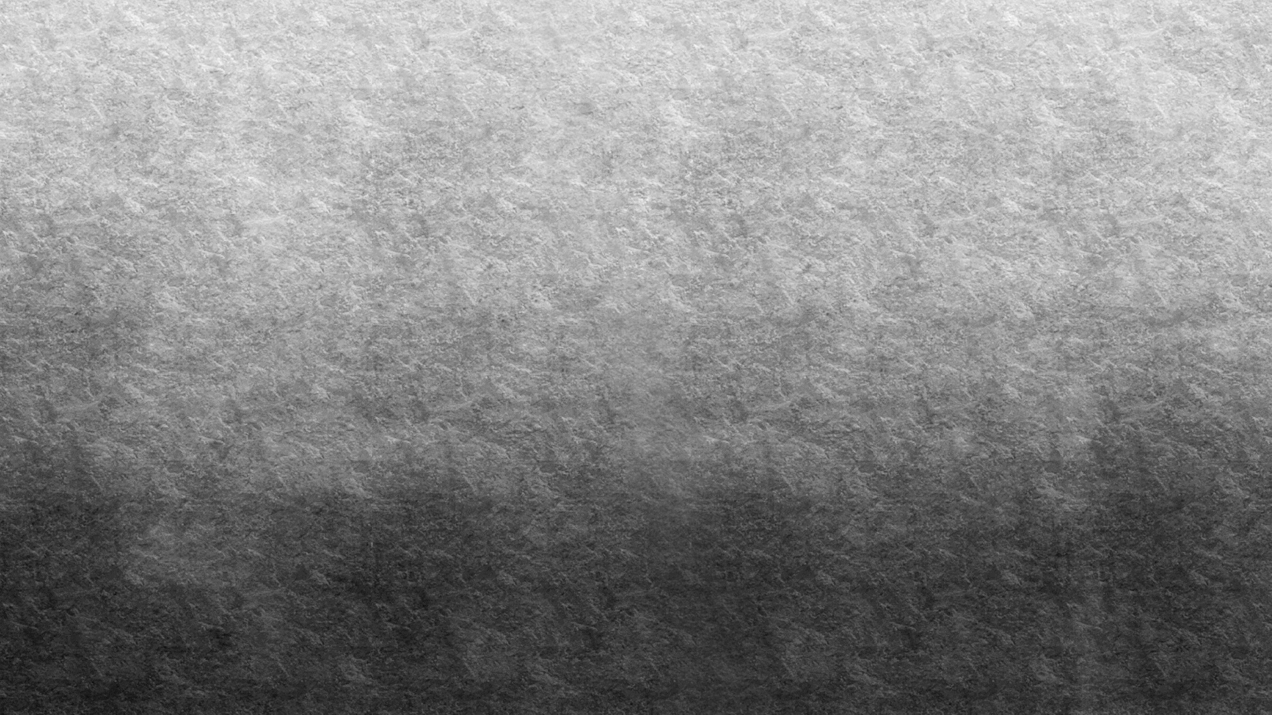


INDIAN INSTITUTE OF INFORMATION TECHNOLOGY, KALYANI
FINAL PROJECT REPORT
WATER BODY DETECTION AND ANALYSIS ON SATELLITE IMAGES

Slide 2


TABLE OF CONTENT
INDIAN INSTITUTE OF INFORMATION TECHNOLOGY, KALYANI
Acknowledgements
Abstract
Water Body detection
NIR vs SWIR1 vs SWIR2
Noise removal techniques
Edge detection
Discussion
Future scope
Bachelor Thesis by
Allu Vamsi Pavan Kumar (CSE/19010/437),
Vedant Gupta (CSE/19069/496),
Vineel Sai (CSE/19071/498)
Under the supervision of
Dr. Pratik Chakraborty

Slide 3
ACKNOWLEDGEMENTS
We would like to express our sincere thanks and gratitude to our Super-visor Dr. Pratik Chakraborty, who gave us the golden opportunity to do this wonderful project and guided us immensely through the course of the project. We came to know about so many new things, all thanks to him.
We would alike to express our sincere thanks to Dr. Oishila Bandhopadhyay, who guided us regarding the project and we were lucky that we have learnt a lots of concepts from her. We must thank to our classmates for their timely help and support for completion of this project. Last but not the least, We would like to thank all those who had helped directly or indirectly in this project.

Slide 4
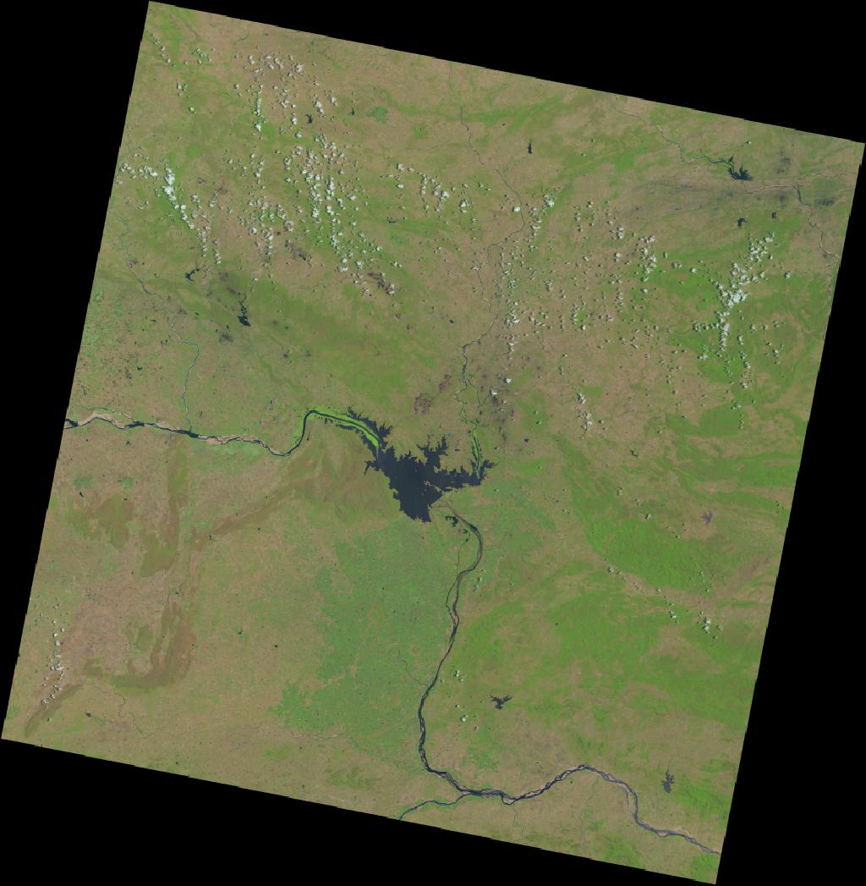
ABSTRACT
The size, Shape, Connectivity of waterbodies can have drastic effects ecological communities and ecosystem processes. In this we have analyzed the water body detection capability of three NDWI models (SWIR1, SWIR2 and NIR) generated using Landsat-8 OLI multispectral satellite images on Hirakud Lake Region from the timestamp 25/05/2020 . It analyses claculates the area of a particular Water body, and calculates the area and figures out the difference between the areas and change in the shape of the water bodies. This study mainly focuses on the changes in the Area of the waterbody occurred from past few years.

Slide 5
WATERBODY DETECTION
Methods of waterbody Extraction
Color Detection :
Using basic OpenCV color detection we could extract the water bodies based on the color of the water.
Deep learning :
Based on deep learning framework, multi-layer perceptron(MLP) is used in this study to extract surface water. In this model, each neuron in each layer need to be fully connected.
Maximum Likelihood :
Maximum likelihood is a type of classical supervision classification method based on statistical analysis. The training samples are assumed to be distributed in Gaussian normal distribution, and then are selected for estimating parameter of distribution function.
NDWI :
Normalized difference water index(NDWI) is the most used index to enhance the water information.

Slide 6

NIR vs SWIR1 vs SWIR2
Normalized Difference Water Index (NDWI) may refer to one of at least two remote sensing indexes related to liquid water.
Formula
For NIR
NDWI = $\frac{green − NIR}{green + NIR}$
2. For SWIR1
NDWI = $\frac{green −SWIR1}{green +SWIR1}$
3. For SWIR2
NDWI = $\frac{green −SWIR2}{green +SWIR2}$
We have used NDWI model to extract the water bodies from the satellite images of the Hirakud dam area.
The extraction is done in on NIR ,SWIR1 and SWIR2 bands.

Slide 7
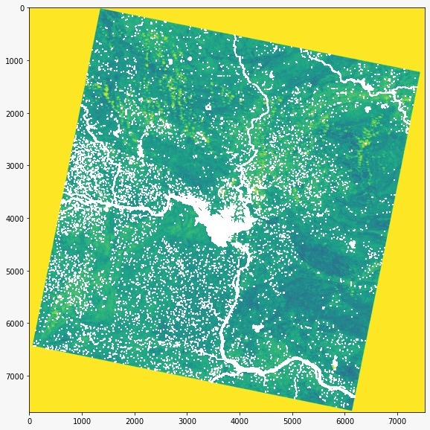
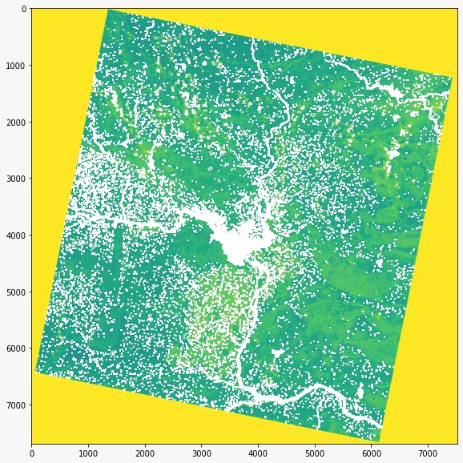
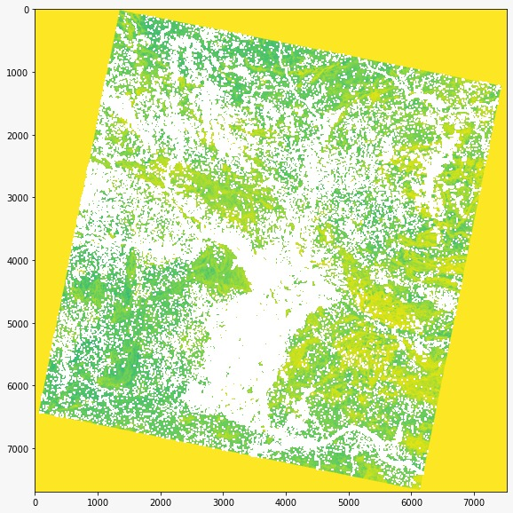
Bands Used
Band3 - green (0.53 – 0.59)
Band5 - NIR (0.85 – 0.88)
Band6 - SWIR1 (1.57 – 1.65)
Band7 – SWIR2 (2.11 - 2.29)
SWIR1 - Discriminates moisture content of soil and vegetation; penetrates thin clouds
SWIR2 - Improved moisture content of soil and vegetation; penetrates thin clouds
Experimental Results
NIR band
SWIR1 band
SWIR2 band

Slide 8

Observations
From the meta data provided by the Geo-Earth i.e. the Latitudes and Longitudes Area of the tile is calculated which helps in the calculation of the area covered by the waterbody
Area of the Tile = 323
And Calculated the Area covered by Water bodies in the tile. (i.e. the area of the white pixels in the tile.)
${Area}_{NIR}$ = 2.0 ${km}^{2}$
${Area}_{SWIR1}$ = 3.0 ${km}^{2}$
${Area}_{SWIR2}$ = 6.0 KM
It can be observed that there are a lot of noise in SWIR2 band images.
Observed from the Meta data :
CORNER_UL_LAT_PRODUCT = 16.94510
CORNER_UL_LON_PRODUCT = 79.91622
CORNER_UR_LAT_PRODUCT = 16.94524
CORNER_UR_LON_PRODUCT = 82.05748
CORNER_LL_LAT_PRODUCT = 14.84356
CORNER_LL_LON_PRODUCT = 79.92742
CORNER_LR_LAT_PRODUCT = 14.84368
CORNER_LR_LON_PRODUCT = 82.04656

Slide 9
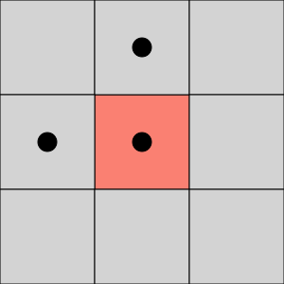
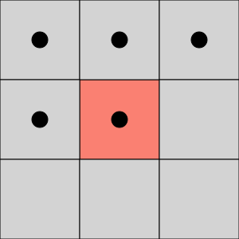
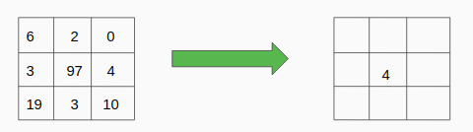
NOISE REMOVAL TECHNIQUES
1 . Connected Component Analysis
Connected Component Analysis can be of two types
4 Connected Neighbour
8 Connected Neighbour
4 Connected Neighbour
8 Connected Neighbour
2. Median Filter:
Mean filter is a simple sliding window that replace the center value with the Median of all pixel values in the window. The window or kernel is usually a square but it can be of any shape.

Slide 10
Implementation of Connecting components :
On the first pass:
1. Iterate through each element of the data by column, then by row (Raster Scanning)
2. If the element is not the background
Get the neighbouring elements of the current element
If there are no neighbours, uniquely label the current element and continue
Otherwise, find the neighbour with the smallest label and assign it to the current element
Store the equivalence between neighbouring labels
On the second pass:
1. Iterate through each element of the data by column, then by row
2. If the element is not the background
Relabel the element with the lowest equivalent label

Slide 11
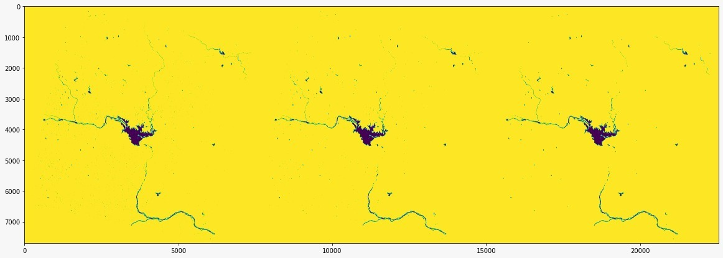
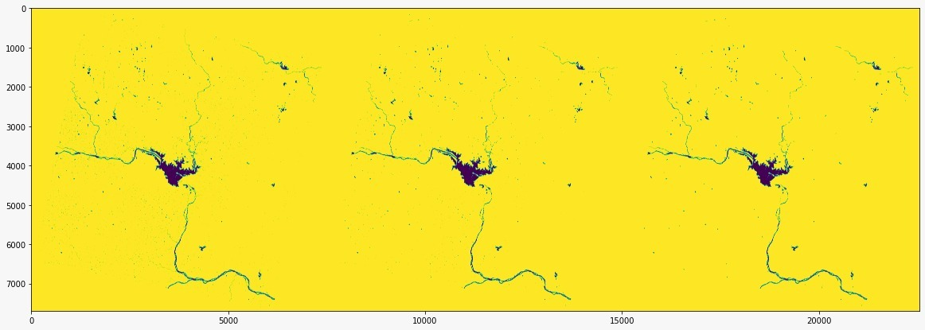
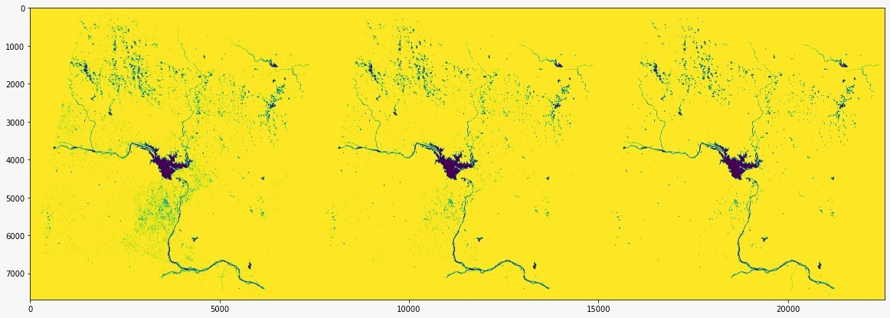
Experimental Results
Connected Components
Base
Median Filter
NIR
SWIR-1
SWIR-2

Slide 12
Observation
NIR
Base : 3.3909186207713016 KM2
Median Filter : 3.1232392062161805 KM2
Connected Components : 3.083140621074842 KM2
SWIR1
Base : 4.09051357105924 KM2
Median Filter : 3.6689060687717525 KM2
Connected Components : 3.583258930643658 KM2
SWIR2
Base : 7.941295564721472 KM2
Median Filter : 6.313888260618718 KM2
Connected Components : 5.690112637590087 KM2

Slide 13
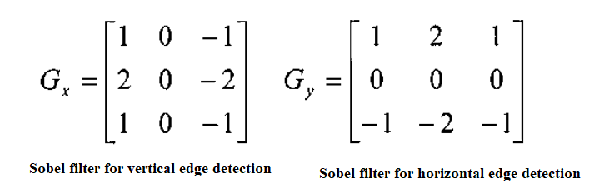
EDGE DETECTION
Edge detection is a technique of image processing used to identify points in a digital image with discontinuities, simply to say, sharp changes in the image brightness. These points where the image brightness varies sharply are called the edges (or boundaries) of the image.
It is one of the basic steps in image processing, pattern recognition in images and computer vision.
Sobel Edge Detection: This uses a filter that gives more emphasis to the centre of the filter. It is one of the most commonly used edge detectors and helps reduce noise and provides differentiating, giving edge response simultaneously. The following are the filters used in this method-

Slide 14
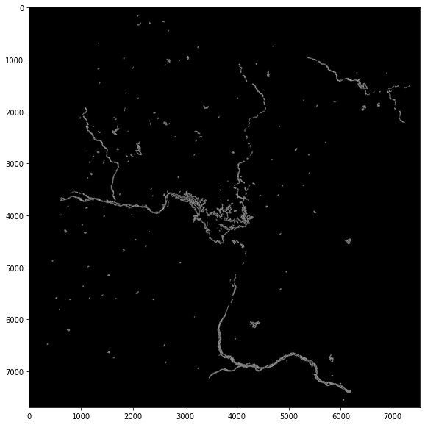

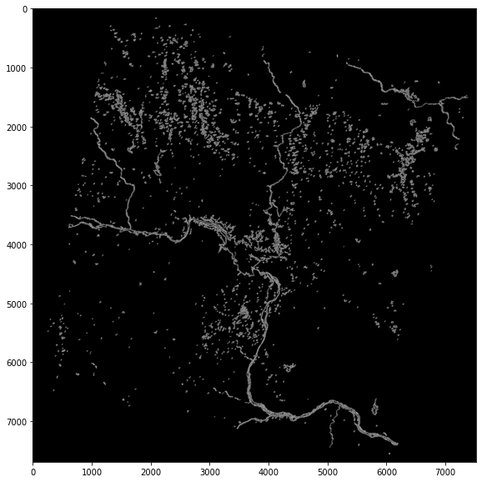
Experimental Results
NIR Edges
SWIR1 Edges
SWIR2 Edges

Slide 15
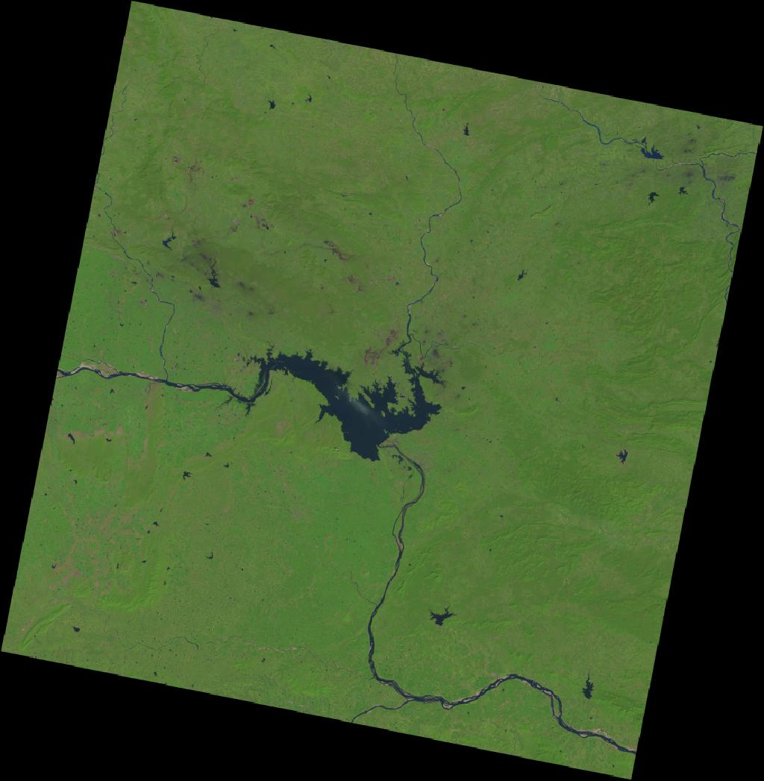
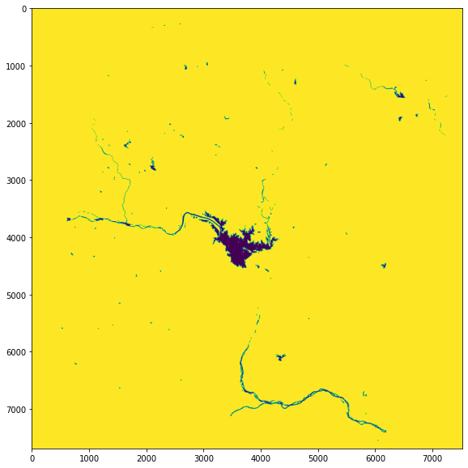
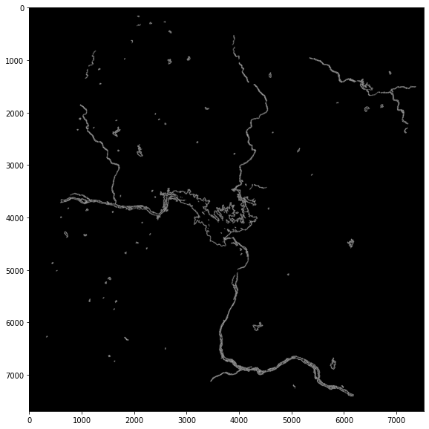

DISCUSSION
Now we have performed analysis on the same region which was collected on 03/11/2021. (The Analysis was performed on SWIR1 band)
We calculated the area of the water bodies.
${Area}_{SWIR1}$ = 5.36 ${km}^{2}$

Slide 16

Inference
Previously calculated Area was 3.5${KM}^{2}$
So the Area of the water body have increased by 2.
The amount of water in rivers and lakes is always changing due to inflows and outflows. Inflows to these water bodies will be from precipitation overland runoff, groundwater seepage, and tributary inflows. Outflows from lakes and rivers include evaporation.
Moreover May is the peak of Summer season which resulted in the decrease of Water level from the Hirakud lake region.
So this might be the reason for the increase in the area of the Water region

Slide 17
FUTURE SCOPE
We would perform analysis on the previous satellite images of this region and collect information such as Area and other small connected water bodies near it.
We further would develop a machine learning model which would predict the future changes that can be occurred in that region.
Generalize the model for any Water body region.

Slide 18
THANK YOU
Allu Vamsi Pavan Kumar (CSE/19010/437),
Vedant Gupta (CSE/19069/496),
Vineel Sai (CSE/19071/498)

